Slide 1
Early Career Framework
Webinar

Slide 2

About us
Delivering the DfE’s golden thread for teacher development.
  Best Practice Network is a Lead Provider for the ECF & NPQs
  20,000+ participants actively engaged and supported through 80+ delivery partners and 2,000+ associate facilitators, assessors, tutors and coaches
  Wider programme offer includes Apprenticeships, ITT, HLTA & NASENCO
Every child able to benefit from an excellent education, regardless of background
Every education professional able to grow and give their best
Inspire Learning
Work Together
Act with Integrity
Strive for Excellence
“Highly responsive to the feedback from stakeholders and continually revise the delivery of the NPQ and ECF programmes”
Ofsted 2021

Slide 3
ECF Programme Design
The design of our Early Career Development Programme aims to improve teacher retention through:
  Thoughtful sequencing and module design which tracks well against a typical school year
  Core content exemplifying expertise in teacher development
  Focus on practitioner inquiry in year 2, that will have wider benefits for school improvement, enabling an increasingly personalised and individual approach
  Clearly presented training outlines that allow for personalisation, contextualised resources, and needs-led inquiry to support and challenge ECTs with different starting points
  Strong focus on building a community of network support through training and school-visit activities
  Designed to build progression from ITT through to NPQ
  Multi-media practice examples enrich online learning & reflect school context

Slide 4
Modules
Year 1 | Contents
Module 1: Enabling pupil learning | Setting high expectations for learning and behaviour, and practical strategies for shaping the learning environment to enable pupil learning.
Module 2: Engaging pupils in learning | Developing a rich conceptual understanding of pupil learning, memory and subject / specialism expertise.
Module 3: Developing quality pedagogy | Exploring and applying strategies to support high quality planning and adaptive teaching that addresses the needs of all pupils.
Module 4: Making productive use of assessment | Investigating approaches to assessment and feedback that improve learning and make efficient use of time, in and out of the classroom.
Module 5: Fulfilling professional responsibilities (I) | Building skills in working with others within and beyond the school to improve teaching and manage professional development across a career in education.
Year 2
Module 6: Enquiry into enabling pupil learning
Module 7: Enquiry into engaging pupils in learning
Module 8: Enquiry into developing quality pedagogy and making productive use of assessment
Module 9: Fulfilling professional responsibilities (II)

Slide 5
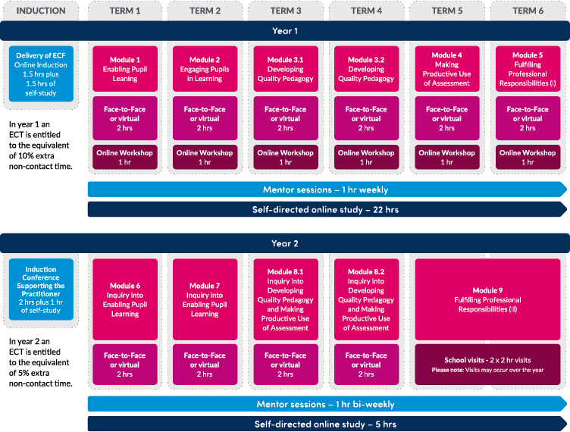

Slide 6
The importance of Mentors
Mentors play an integral role in the success of the ECF programme:
Choosing the right mentor is essential because it is a significant commitment, BPN are happy to provide guidance on choosing the right person
Ensuring the mentor has dedicated, protected time for their own training and ECT meetings, using DfE funding wisely to support this
Wherever possible, having an ECF mentor and a separate induction tutor
Allowing the mentor to complete the full ECF programme, where possible, with their ECT to avoid disruption to the ECT and mentor’s access to their professional development
Notes:
Facilitator Notes
This is the biggest push for schools at the moment to fully understand, appreciate and support the mentors to access the programme fully. Ofsted have recognised how the programme is set up to guide and support them through, and is high quality, but that they share they often are not being given the time to do the role as they want to. We need our facilitators to support us all in raising the profile of the mentors and giving the confidence to return to school leaders detailing their role in the ECTs journey and being clear on what time / support they need to access events, mentor meetings with their ECT and self-study.

Slide 7
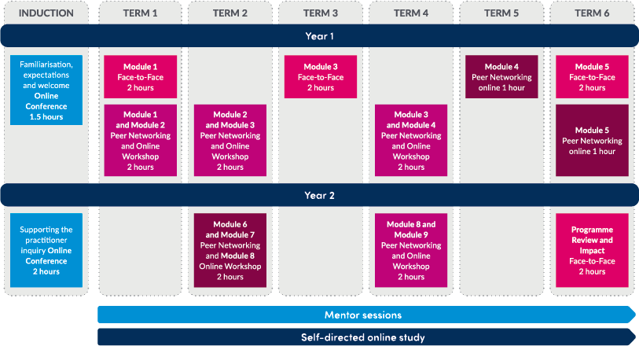

Slide 8
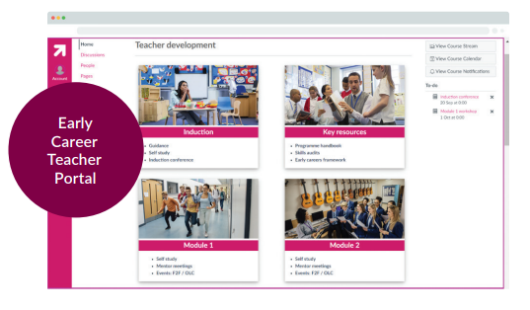
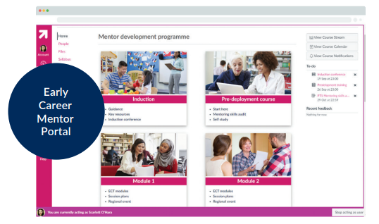
The Canvas VLE
  Purpose built VLE
  Video guidance & drop-in support sessions
  Access for ECTS, ECMS & ITs
  Multi-media practice examples
  Case studies & exemplars contextualised for needs of all participants and schools
  Access to programme & event resources

Slide 9
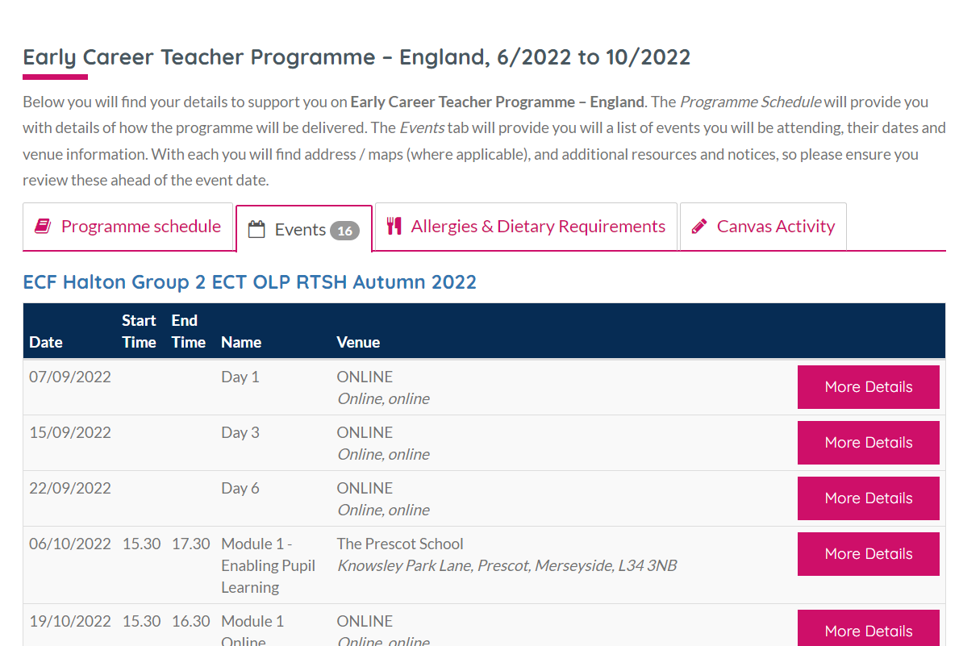
Supporting learners
  Participant, Induction Tutor and Headteacher support from a dedicated ECF support team
  Centralised programme and event communications
  Participant dashboard featuring programme schedule, event info, online event links, engagement tracking and VLE access
  Access to ‘catch-up’ events to ensure engagement

Slide 10
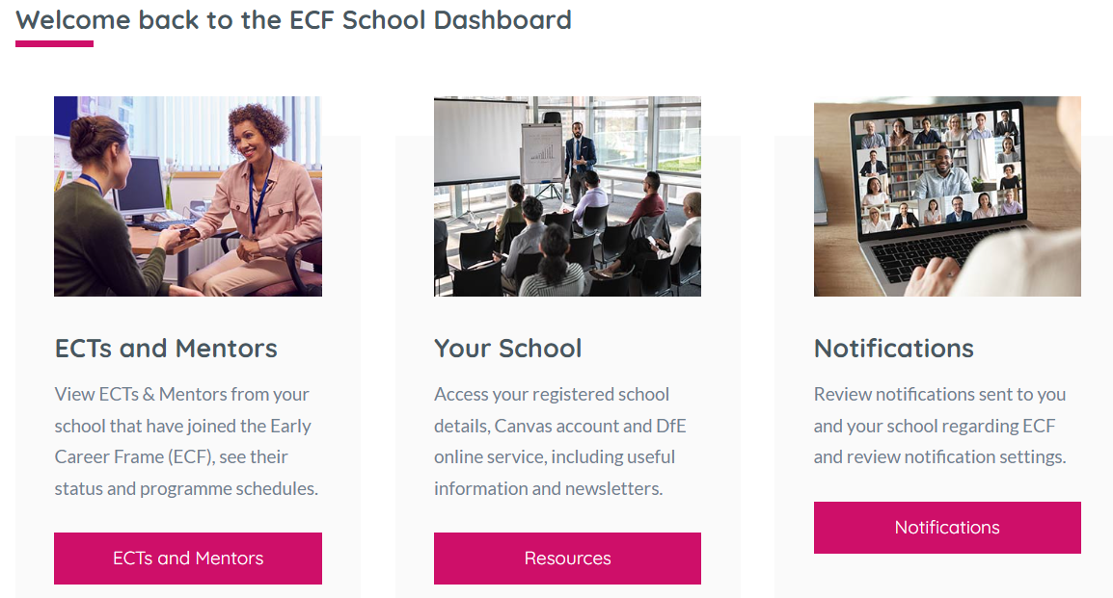
School dashboard
Enabling Induction Tutors and Headteachers to:
  Monitor ECT and Mentor registrations
  Access ECT and Mentor programme schedules
  Monitor ECT and Mentor engagement
  Notify us of changes in relation to their ECTs and Mentors
  Access the latest newsletters, policies and guidance
  Direct access to participant learning on our VLE, Canvas

Slide 11


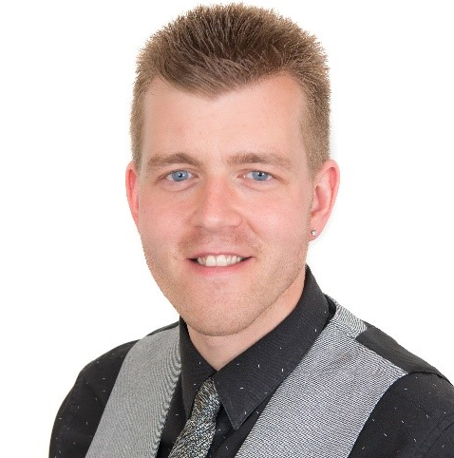
“The support and guidance we have received from the ECF team at Best Practice has been exceptional. Their attention to detail and the time they made available to us to during set-up made our transition to them as our Lead Partner for 2022-23 a very smooth one.”
Karen Taylor-Paul, Director of Alban Teaching School Hub
“Schools have commented on how fabulous the materials are and how much a step up the training is. Our facilitators have been really happy with the quality of training delivery, how professional it has been, but also how it fits within our local context. This has been greatly valued in terms of the impact day-to-day in transitioning to a new provider. The transition was easy.”
Samantha Torr, Director of Alpha Teaching School Hub
“Our ability to maintain the highest possible quality of programme delivery, coupled with providing an excellent participant learning experience, is always the driving force behind our decision making. For the team and I, this is where the benefits of BPN’s partnership model comes to the fore. The back-office and programme management function, delivered through BPN, removes the huge administrative burden”
David Higginbottom, Deputy Director of HISP Teaching School Hub

