Slide 1
National Professional Qualifications (NPQs)
An introduction to the new programmes

Slide 2
Best Practice Network & Outstanding Leaders Partnership
Every child able to benefit from an excellent education, regardless of background
Every education professional able to grow and give their best
School-led CPD provider since 2012
Proven infrastructure having supported 14,000+ participants over the last 3yrs
Deliver accredited CPD through a 160 strong national partner-led model
Provider of Apprenticeships, ECF, EYITT, HLTA, NASENCO & more
Exceeding DfE performance metrics
Dedicated and expert programme, participant and partner support teams
Inspire Learning
Strive for
Excellence
Work
Together
Act with Integrity
Known & Trusted | | | 98% Satisfaction
‘Exceptional’ Provision | | | 95% Pass Rate
2

Slide 3
A clearer career pathway
Through the revised Initial Teacher Training Core Content Framework and the implementation of the Early Career Framework, the DfE are now supporting teachers in the first years of their career with a structured two-year induction into the profession.
The NPQs and New Headteacher Programme build on this foundation to provide continuous career pathways with training and support for teachers and leaders at all levels.
The revised suite of specialist and leadership NPQs will complete the golden thread from initial teacher training through to school leadership, rooting teacher and leader development in the best available evidence and collective wisdom of the profession.

Slide 4
NPQ programmes
NPQ Leading Teacher Development | For those who are, or aspire to, lead the development of other teachers
NPQ Leading Teaching | For those who are, or aspire to, lead teaching in a subject, year group, key stage or phase
NPQ Leading Behaviour & Culture | For those who are, or aspire to, lead behaviour and culture and/or pupil well-being
NPQ Senior Leadership | For those who are, or aspire to be, senior leaders leading across a school
NPQ Headship | For those who are, or aspire to be, headteachers leading across a whole school
NPQ Executive Leadership | For those who are, or aspire to be, executive leaders with responsibility across more than one school
So what’s changed?
NPQ content areas are threaded from the Early Career Framework
Specialist NPQs to support career pathway width and replace old middle leader NPQ
Assessed school-improvement projects have been replaced with practice-based formative and summative assessment tasks
Behaviours do not feature in DfE frameworks, however, we have embedded these throughout
Greater emphasis on practice-based activity and participant context

Slide 5
Kylie Spark
NPQs: A headteacher’s point of view

Slide 6
Programmes overview
Specialist NPQs – NPQLT, NPQLTD & NPQLBC

Slide 7
Programmes overview
Leadership NPQs - NPQSL

Slide 8
Programmes overview
Leadership NPQs - NPQH

Slide 9
Programmes overview
Leadership NPQs - NPQEL

Slide 10
DfE Framework Content Areas | Leadership NPQs | Specialist NPQs
 |  | NPQLTD | NPQLBC | NPQLT
1. School Culture
2. Teaching
3. Curriculum & Assessment
4. Behaviour
5. Additional and Special Education Needs/Disabilities
6. Professional Development
7. Organisational Management
8. Implementation
9. Working in Partnership
10. Governance and accountability

Slide 11
NPQ programme structure
access, relevance and choice for all
research evidence underpins pedagogy and content
practice-led learning to develop and embed expertise
clear professional journey aligned to DfE ‘golden thread’

Slide 12
NPQ cyclical learning pathway
Profile & Audit
Face-to-face
Online course
Formative Assessment Task
Profile Review
3 weekly Units
Complete a minimum of 3 formative activities from across units
Complete 1 overall learning reflection
Receive online mentor/coach feedback
Introduce key concepts & research from content area
Prepare participants for online study
Define focus of practice based activity
Review and refine needs & upload to coach / mentor
Skills audit
Develop professional profile
Coach / Mentor review
Refine Professional Profile
Coach / Mentor review
Select Formative Assessment Task and complete over 4-weeks
Coach / Mentor review and feedback

Slide 13
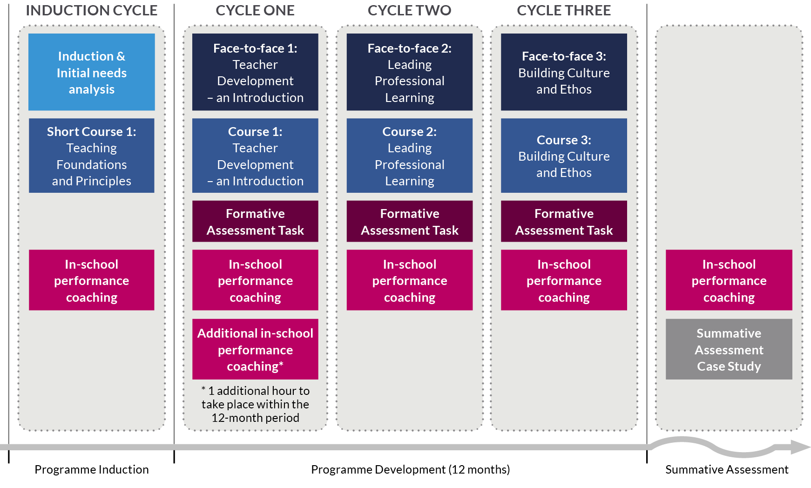
NPQ Programme
Specialist Programme
NPQLTD
12 Months

Slide 14
NPQ Programme
Specialist Programme
NPQLT
12 Months

Slide 15
NPQ Programme
Specialist Programme
NPQLBC
12 Months

Slide 16
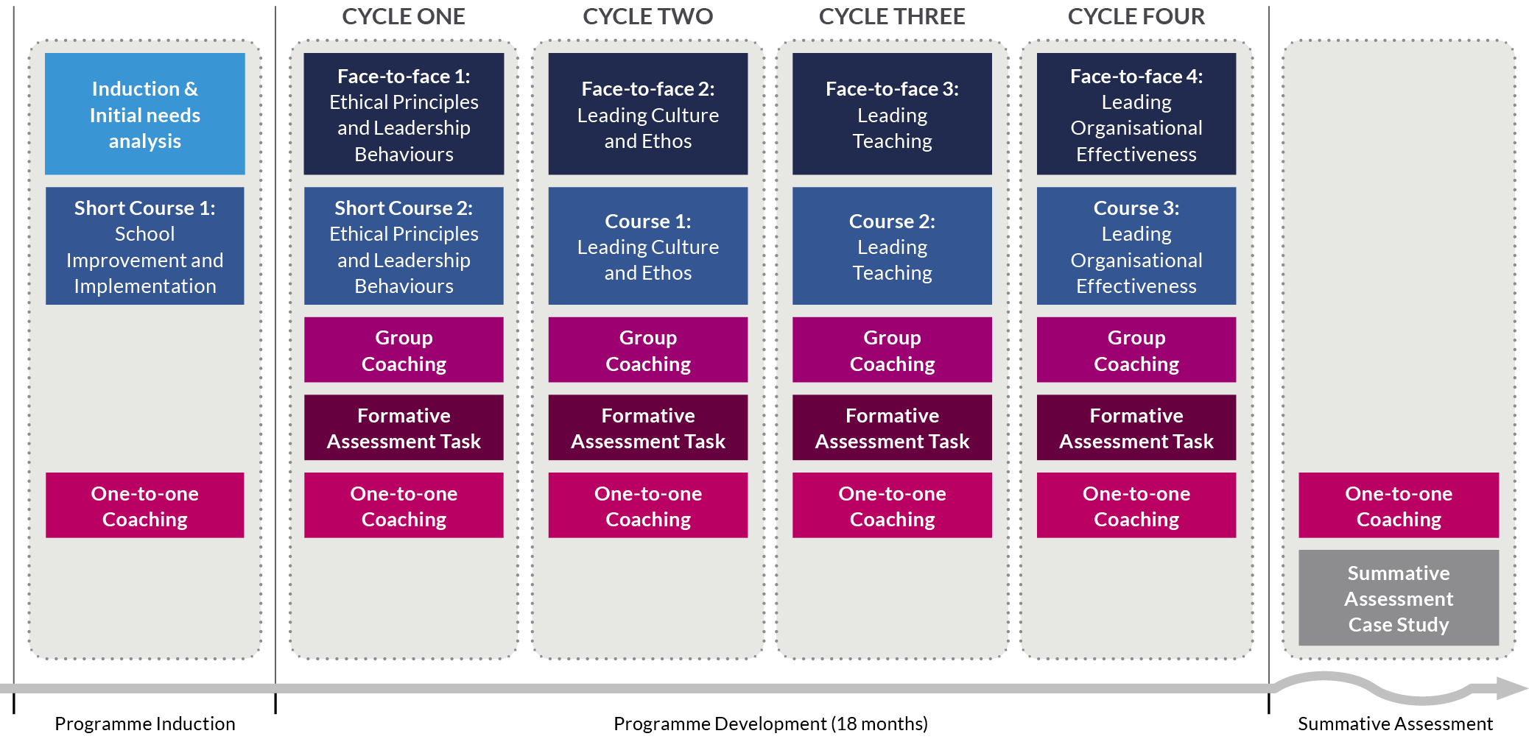
NPQ Programme
Leadership Programmes
NPQSL
18 Months

Slide 17
NPQ Programme
Leadership Programmes
NPQH
18 Months

Slide 18
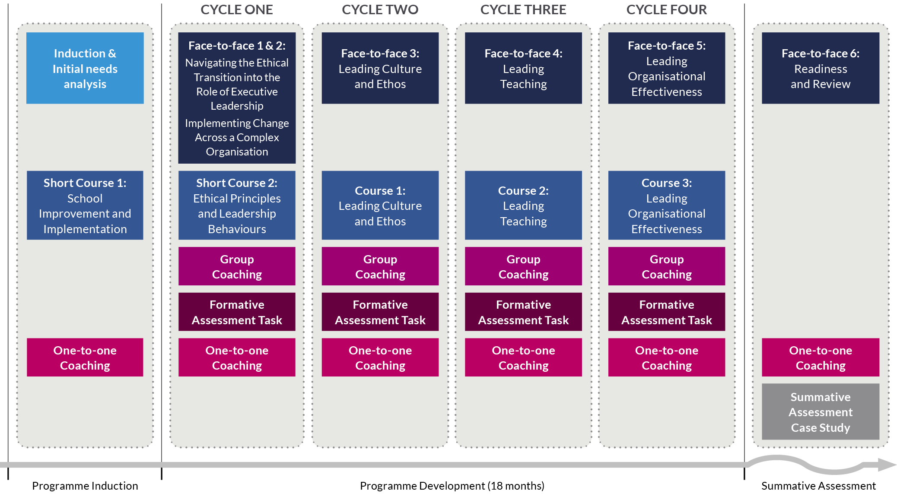
NPQ Programme
Leadership Programmes
NPQEL
18 Months

Slide 19
Programme fees (TBC)
Programme | Course fee | State funded schools
National Professional Qualification for Leading Teacher Development (NPQLTD) | £895 | Free to access
National Professional Qualification for Leading Behaviour and Culture (NPQLBC) | £895 | Free to access
National Professional Qualification for Leading Teaching (NPQLT) | £895 | Free to access
National Professional Qualification for Senior Leadership (NPQSL) | £1,135 | Free to access
National Professional Qualification for Headship (NPQH) | £1,975 | Free to access
National Professional Qualification for Executive Leadership (NPQEL) | £4,090 | Free to access

Slide 20
Apprenticeship funded routes
Apprenticeships are work-based training programmes for new and existing staff
All schools have access to Apprenticeship Levy funding either through their trust, LA or the ESFA’s co-investment scheme
Best Practice Network are a registered Apprenticeship Provider and have supported 800+ participants to access NPQs utilising levy funding
Our NPQSL & NPQEL have been mapped against Level 5 to Level 7 Apprenticeship Standards creating ‘dual-award’ programmes
The dual-award programmes provide participants the DfE’s NPQs inside the comprehensive wraparound support of an apprenticeship
Please join our NPQ Apprenticeship webinar on 8 December to find out more: https://us06web.zoom.us/webinar/register/WN_kn4Q-PNFQCOTxcZ0CcwUrw

Slide 21
Next steps
NPQs can be viewed at www.bestpracticenet.co.uk/npq or www.outstandingleaders.org/npq
Download qualification specifications
Discuss with school CPD lead or headteacher
Contact us through the live chat function on our web site, cpd@bestpracticenet.co.uk or phone 0117 920 9200
Apply sooner rather than later to avoid the last minute rush!

